Slide 1
Notes:
Topics:
Introduction to Repetition Structures
The while Loop: a Condition-Controlled Loop
The for Loop: a Count-Controlled Loop
Calculating a Running Total
Sentinels
Input Validation Loops
Nested Loops

Slide 2
Introduction to Repetition Structures
Often have to write code that performs the same task multiple times
Disadvantages to duplicating code
Makes program large
Time consuming
May need to be corrected in many places
Repetition structure: makes computer repeat included code as necessary
Includes condition-controlled loops and count-controlled loops
Notes:
Repetition structure aka a loop. In Python, you use the while statement to write a condition-controlled loop, and you use the for statement to write a count-controlled loop.

Slide 3
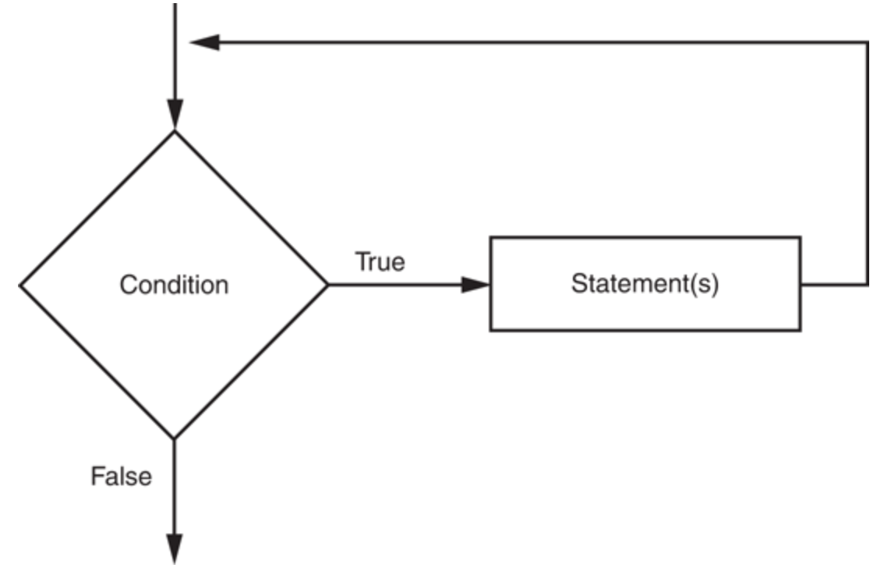
The while Loop: a Condition-Controlled Loop
while loop: while condition is true, do something
Two parts:
Condition tested for true or false value
Statements repeated as long as condition is true
In flow chart, line goes back to previous part
General format:
while condition:
statements

Slide 4
The while Loop: a Condition-Controlled Loop (cont’d.)
In order for a loop to stop executing, something has to happen inside the loop to make the condition false
Iteration: one execution of the body of a loop
while loop is known as a pretest loop
Tests condition before performing an iteration
Will never execute if condition is false to start with
Requires performing some steps prior to the loop

Slide 5
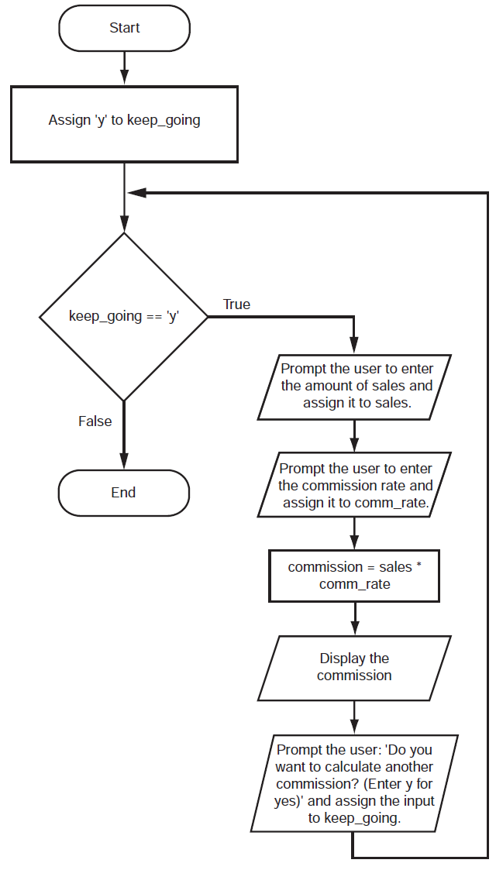
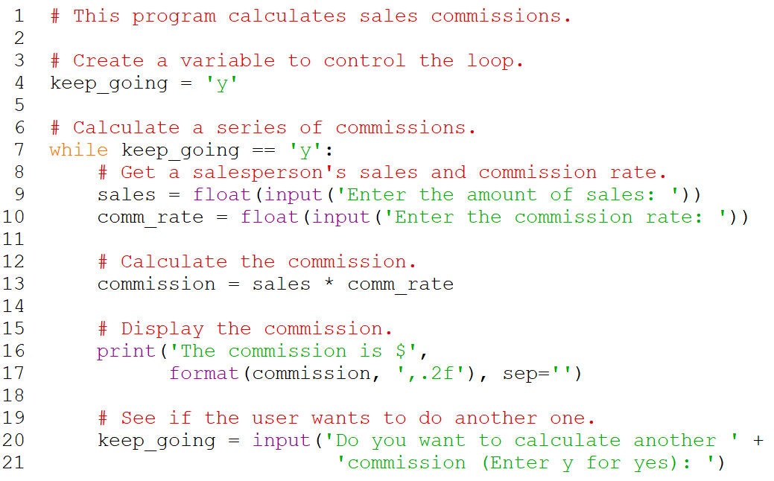
Sales Commissions Example
Notes:
while keep_going == 'y’:
The loop will perform an iteration only if the expression keep_going =='y' is true. This means that (a) the keep_going variable has to exist, and (b) it has to reference the value 'y'. To make sure the expression is true the first time that the loop executes, we assigned the value 'y' to the keep_going variable in line 4 as follows:
keep_going = 'y'

Slide 6
Infinite Loops
Loops must contain within themselves a way to terminate
Something inside a while loop must eventually make the condition false
Infinite loop: loop that does not have a way of stopping
Repeats until program is interrupted
Occurs when programmer forgets to include stopping code in the loop
Notes:
How would we turn the sales commission example on previous slide to an infinite loop?
ANS: don’t prompt the user if he/she wants to keep going

Slide 7
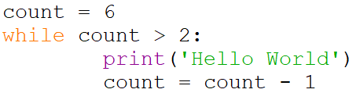
Knowledge Check
How many times will 'Hello World' be printed in the following program?
Notes:
ANS: 4 times

Slide 8
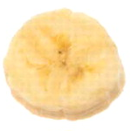
The for Loop: a Count-Controlled Loop
Count-Controlled loop: iterates a specific number of times
Use a for statement to write count-controlled loop
Designed to work with sequence of data items
Iterates once for each item in the sequence
General format:
for variable in [val1, val2, etc]:
statements
Target variable: the variable which is the target of the assignment at the beginning of each iteration
Notes:
Inside the brackets a sequence of values appears, with a comma separating each value. (In Python, a comma-separated sequence of data items that are enclosed in a set of brackets is called a list.

Slide 9
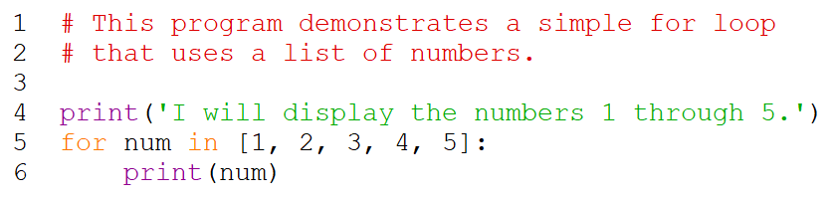
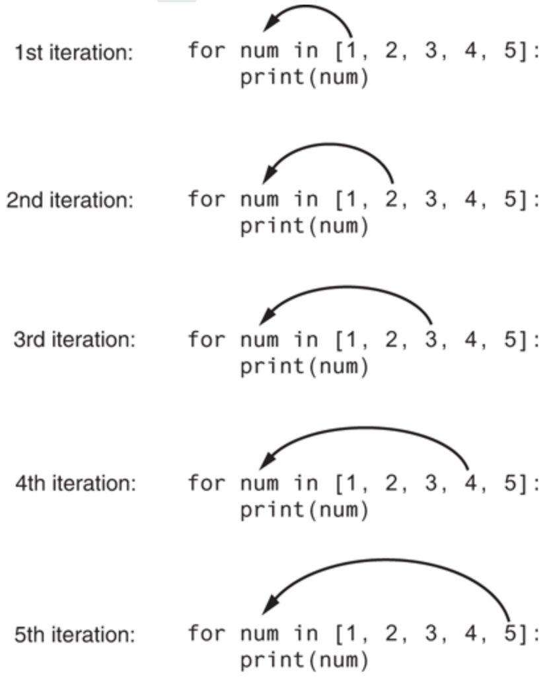
Notes:
Program output:
I will display the numbers 1 through 5.
1
2
3
4
5

Slide 10
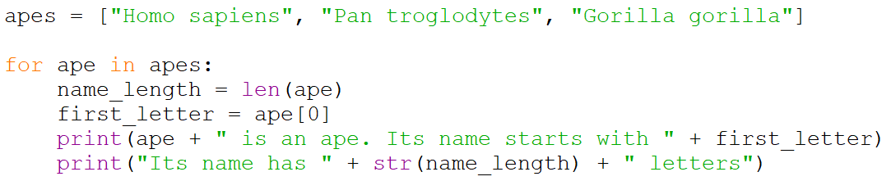
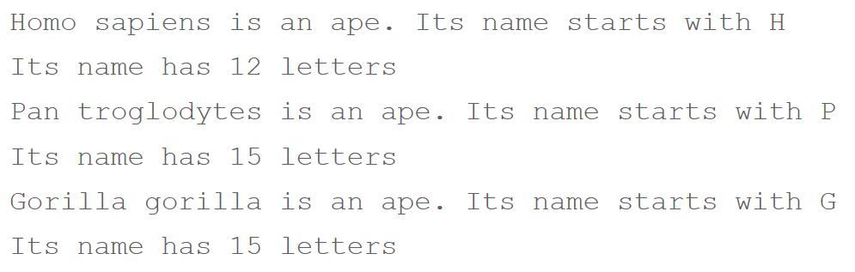
Another for Loop Example
Program
Output
Notes:
Note proper indentation

Slide 11
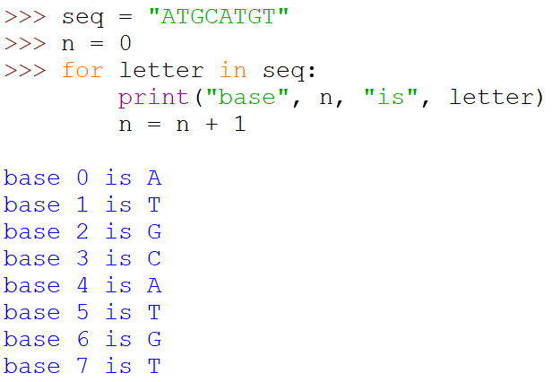
for Loop Works on Strings
A string is similar to a list of letters

Slide 12
Using the range Function with the for Loop
The range function simplifies the process of writing a for loop
range returns an iterable object
Iterable: contains a sequence of values that can be iterated over
range characteristics:
One argument: used as ending limit
Two arguments: starting value and ending limit
Three arguments: third argument is step value

Slide 13
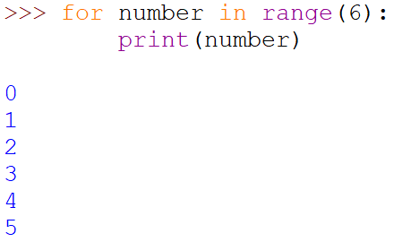
range Examples
One argument: range() will count up from zero to that number, excluding the number itself

Slide 14
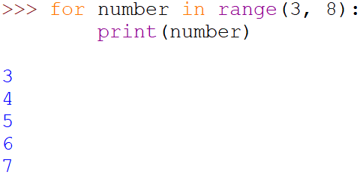
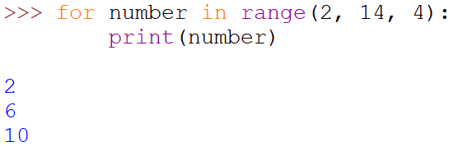
range Examples (cont’d.)
Two arguments: range() will count up from the first number (inclusive) to the second (exclusive)
Three arguments: range() will count up from the first to the second with the step size given by the third
Notes:
Sometimes the programmer does not know exactly how many times the loop will execute
Can receive range inputs from the user, place them in variables, and call the range function in the for clause using these variables

Slide 15
Generating an Iterable Sequence that Ranges from Highest to Lowest
The range function can be used to generate a sequence with numbers in descending order
Make sure starting number is larger than end limit, and step value is negative
Example: range (10, 0, -1)
Notes:
In this function call, the starting value is 10, the sequence’s ending limit is 0, and the step value is -1. This expression will produce the following sequence:
10, 9, 8, 7, 6, 5, 4, 3, 2, 1

Slide 16
Calculating a Running Total
Programs often need to calculate a total of a series of numbers
Typically include two elements:
A loop that reads each number in series
An accumulator variable
Known as program that keeps a running total: accumulates total and reads in series
At end of loop, accumulator will reference the total

Slide 17
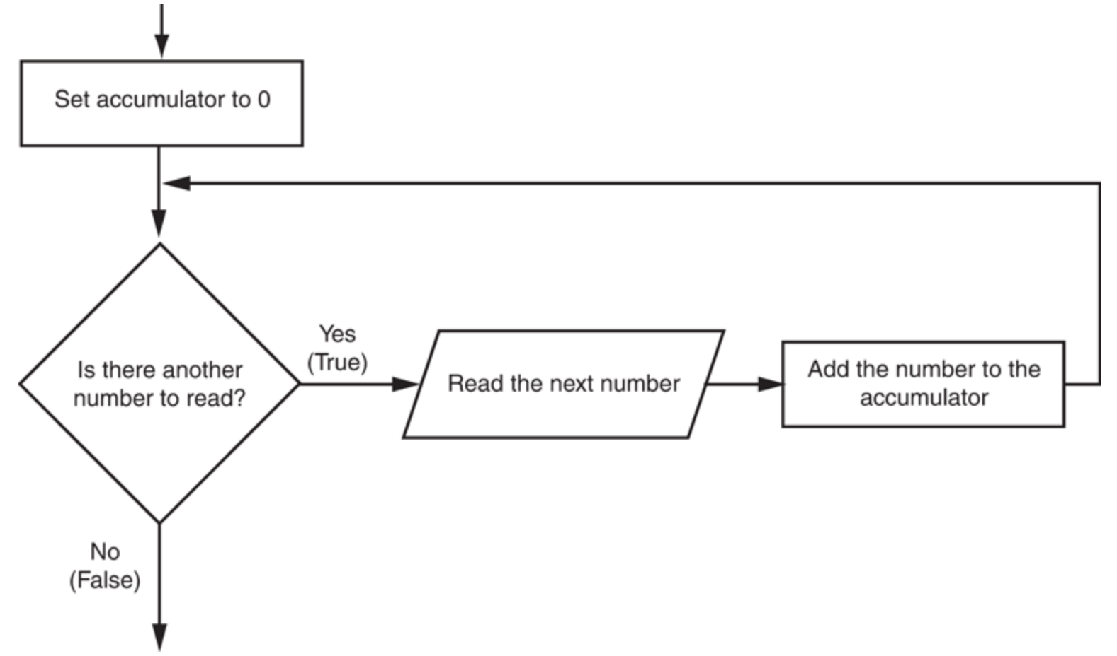
Calculating a Running Total (cont’d.)

Slide 18
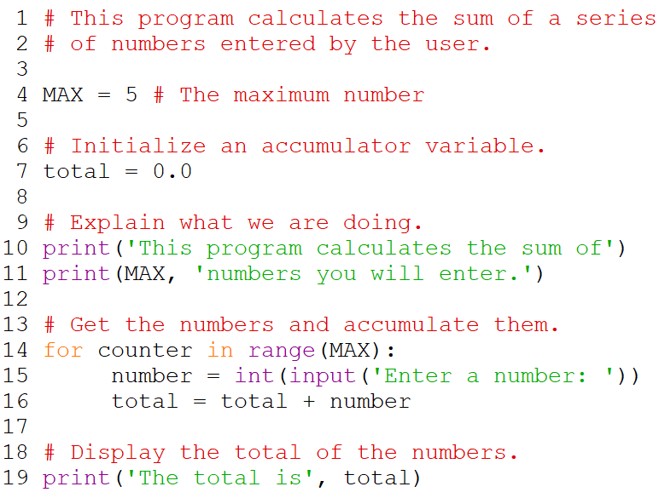
Running Total Example
Notes:
The total variable, created by the assignment statement in line 7, is the accumulator. Notice it is initialized with the value 0.0. The for loop, in lines 14 through 16, does the work of getting the numbers from the user and calculating their total. Line 15 prompts the user to enter a number then assigns the input to the number variable. Then, the following statement in line 16 adds number to total:
total = total + number
After this statement executes, the value referenced by the number variable will be added to the value in the total variable. It’s important that you understand how this statement works. First, the interpreter gets the value of the expression on the right side of the = operator, which is total + number. Then, that value is assigned by the = operator to the total variable. The effect of the statement is that the value of the number variable is added to the total variable. When the loop finishes, the total variable will hold the sum of all the numbers that were added to it. This value is displayed in line 19.

Slide 19
The Augmented Assignment Operators
In many assignment statements, the variable on the left side of the = operator also appears on the right side of the = operator
Augmented assignment operators: special set of operators designed for this type of job
Shorthand operators
Notes:
Ex: x = x + 1
Can be rewritten as: x += 1

Slide 20
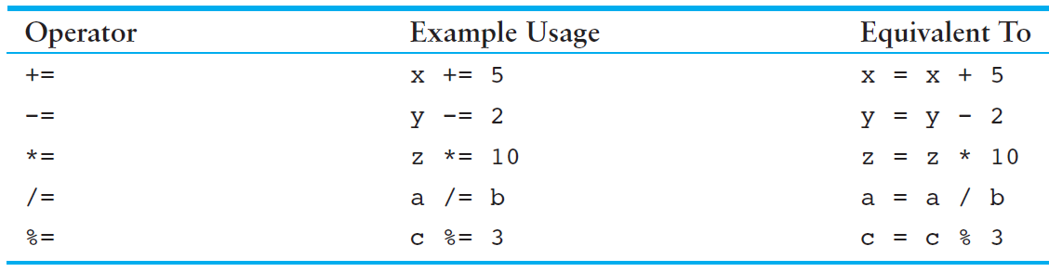
The Augmented Assignment Operators (cont’d.)

Slide 21
Sentinels
Sentinel: special value that marks the end of a sequence of items
When program reaches a sentinel, it knows that the end of the sequence of items was reached, and the loop terminates
Must be distinctive enough so as not to be mistaken for a regular value in the sequence
Example: when reading an input file, empty line can be used as a sentinel
Notes:
At end of program, can ask user for another input or 0 (or -1) to end program.
while num != 0:
Do stuff
print(‘Enter another number or 0 to end.’)
num = int(input(‘Number: ‘))

Slide 22
Input Validation Loops
Computer cannot tell the difference between good data and bad data
If user provides bad input, program will produce bad output
GIGO: garbage in, garbage out
It is important to design program such that bad input is never accepted

Slide 23
Input Validation Loops (cont’d.)
Input validation: inspecting input before it is processed by the program
If input is invalid, prompt user to enter correct data
Commonly accomplished using a while loop which repeats as long as the input is bad
If input is bad, display error message and receive another set of data
If input is good, continue to process the input

Slide 24
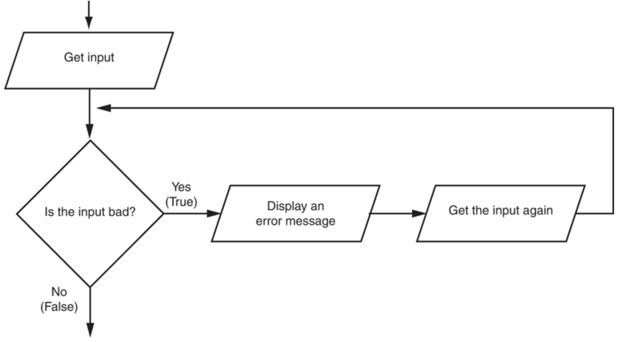
Input Validation Loops (cont’d.)
Notes:
Notice that the flowchart reads input in two places: first just before the loop, and then inside the loop. The first input operation—just before the loop—is called a priming read, and its purpose is to get the first input value that will be tested by the validation loop. If that value is invalid, the loop will perform subsequent input operations.

Slide 25
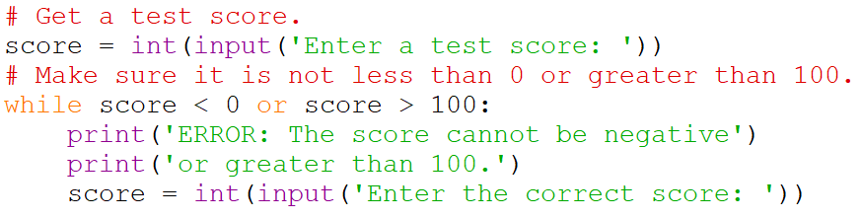
Input Validation Example
Notes:
The loop in this code determines whether score is less than 0 or greater than 100. If either is true, an error message is displayed and the user is prompted to enter a correct score.

Slide 26
Nested Loops
Nested loop: loop that is contained inside another loop
Example: analog clock works like a nested loop
Hours hand moves once for every twelve movements of the minutes hand: for each iteration of the “hours,” do twelve iterations of “minutes”
Seconds hand moves 60 times for each movement of the minutes hand: for each iteration of “minutes,” do 60 iterations of “seconds”

Slide 27
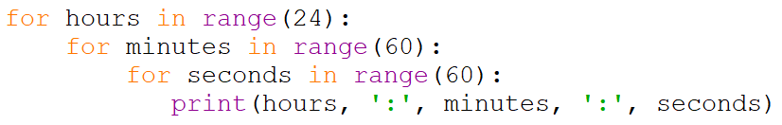
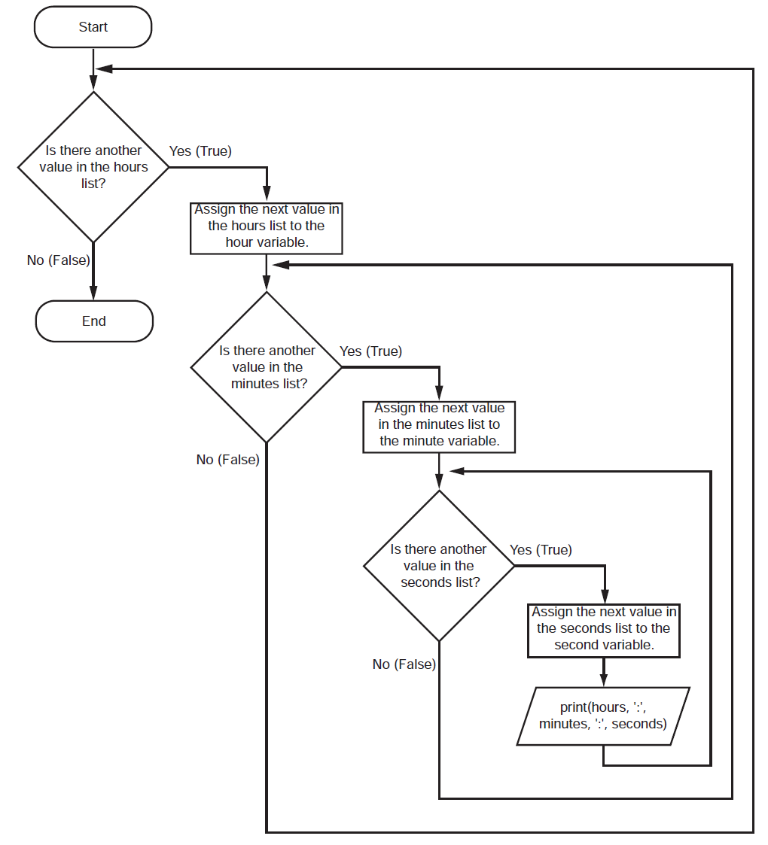
Notes:
This code’s output would be:
0 : 0 : 0
0 : 0 : 1
0 : 0 : 2
(The program will count through each second of 24 hours.)
23 : 59 : 59
The innermost loop will iterate 60 times for each iteration of the middle loop. The middle loop will iterate 60 times for each iteration of the outermost loop. When the outermost loop has iterated 24 times, the middle loop will have iterated 1,440 times and the innermost loop will have iterated 86,400 times!

Slide 28
Nested Loops (cont’d.)
Key points about nested loops:
Inner loop goes through all of its iterations for each iteration of outer loop
Inner loops complete their iterations faster than outer loops
Total number of iterations in nested loop: number_iterations_inner x
number_iterations_outer

Slide 29
Summary
This chapter covered:
Repetition structures, including:
Condition-controlled loops
Count-controlled loops
Nested loops
Infinite loops and how they can be avoided
range function as used in for loops
Calculating a running total and augmented assignment operators
Use of sentinels to terminate loops
Input validation
Nested loops

Slide 30
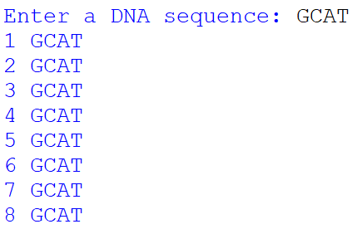
In-class Exercise 3
1. Write a program that prompts the user for a DNA sequence, then prints it 8 times. Include the loop count in the output starting with a count of 1.

Slide 31
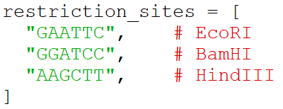
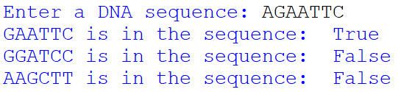
In-class Exercise 3 (cont’d.)
2. The following is a Python list of restriction site patterns:
Write a program to ask the user for a DNA sequence, then say whether each restriction site is or is not present.
Notes:
EcoRI is a restriction enzyme that cleaves DNA double helices into fragments at specific sites. It is also a part of the restriction modification system. In molecular biology it is used as a restriction enzyme. EcoRI creates 4 nucleotide sticky ends with 5' end overhangs of AATT.
BamHI. Restriction endonuclease BamH I bound to a non-specific DNA. BamH I (from Bacillus amyloliquefaciens) is a type II restriction endonuclease, having the capacity for recognizing short sequences (6 b.p.) of DNA and specifically cleaving them at a target site.
HindIII (pronounced "Hin D Three") is a type II site-specific deoxyribonuclease restriction enzyme isolated from Haemophilus influenzae that cleaves the DNA palindromic sequence AAGCTT in the presence of the cofactor Mg²⁺ via hydrolysis.

